Slide 1
The role of your academic adviser
How an academic adviser can help
How to book a meeting (tutorial)
Your role in the process
What to expect
How often do we meet
Additional support functions
Notes:
Sometimes an AA might also be called a personal tutor and different departments do use different names

Slide 2
1. Your academic adviser is here to:
Provide a key contact point between you and the University.
Offer individual support (more than is sometimes possible within a formal teaching context).
Help put any initial anxieties into perspective and guide you through any initial difficulties.
Help you establish realistic expectations.
Encourage effective study patterns.
Contribute to a more fulfilled student experience.
Provide continuity throughout the programme.
Offer informal advice, long after graduation.
Notes:
Students arrive at University with widely different attitudes, prior learning and expectations and with different cultural and socioeconomic backgrounds. Students may have succeeded easily at school, college or other prior entry route, and then find it hard to adapt to the more independent atmosphere of University. Alternatively, they may have experienced academic failures in the past and struggle with low self-confidence
Your role is therefore a vital one and it is important that you know what is expected of you and how you too will be supported.
A surprising number of students, especially in the early months, will assume that everyone else is coping well and that any difficulties they experience must mean they are on the wrong programme or even unsuited to higher education as a whole.

Slide 3
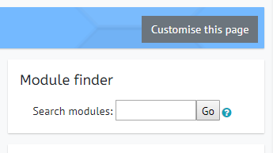
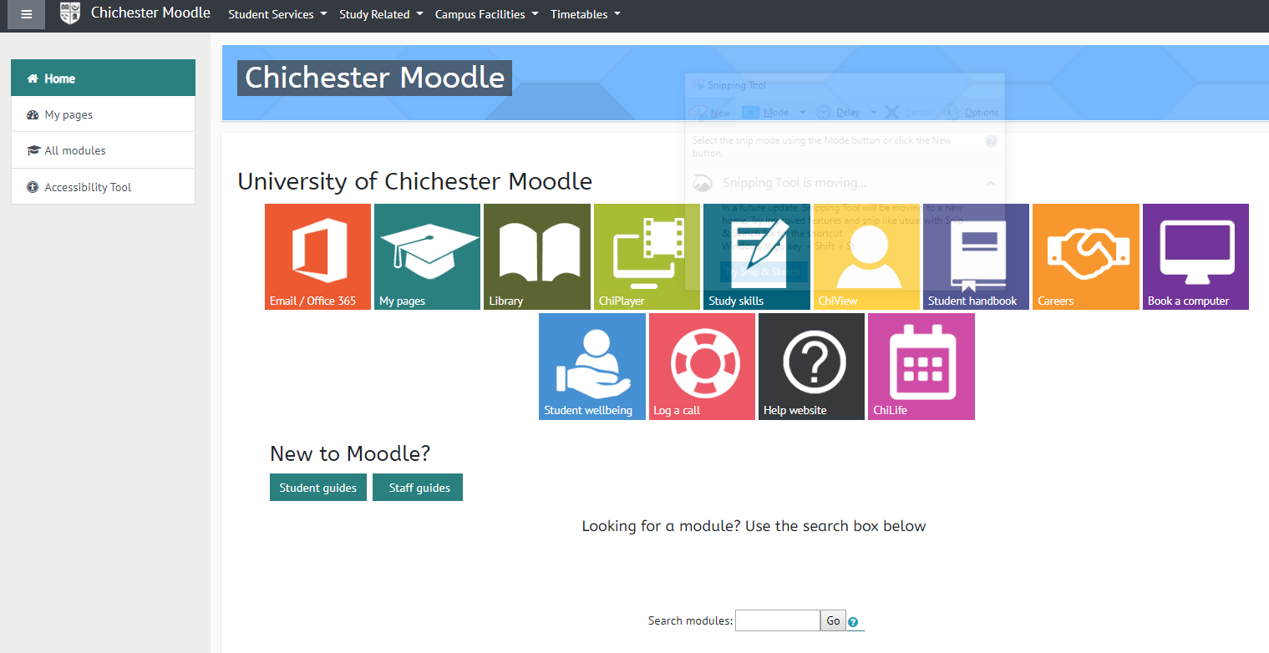
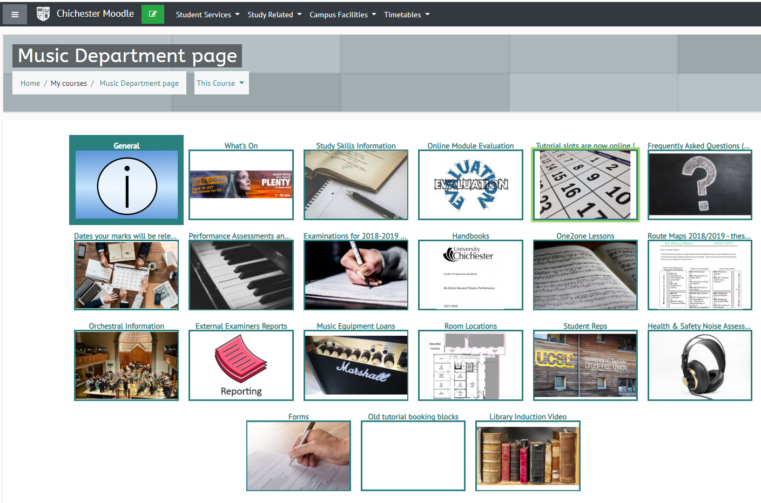
2. How to book a tutorial
Go to Moodle and login
Open the Music Dept page.
If you don’t have the page you can search here.
Notes:
All students of the University of Chichester are entitled: a) To take part in an induction process which prepares them for their programme of study and gives information concerning both their programme and the support systems that are available.
As a minimum this should include the following information:
• A statement that each new student is assigned an Academic Adviser on arrival, and where information about who this is can be found; for example programme notice boards or Moodle.
• A description of how students meet their Academic Adviser for the first time, and the nature of arrangements for subsequent meetings; the description might include reference to a booking system for meetings, regular tutorial hours, or the use of email for setting up meetings or resolving issues online.
• A description about how Academic Adviser arrangements differ as students progress from year one of the programme; for example, while arrangements might be formally timetabled for first year students, second or third year students may be encouraged to

Slide 4
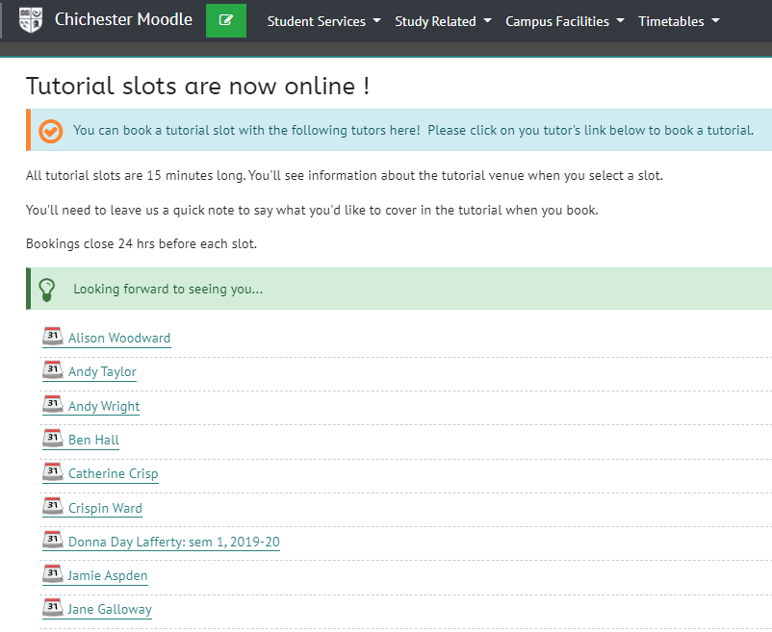
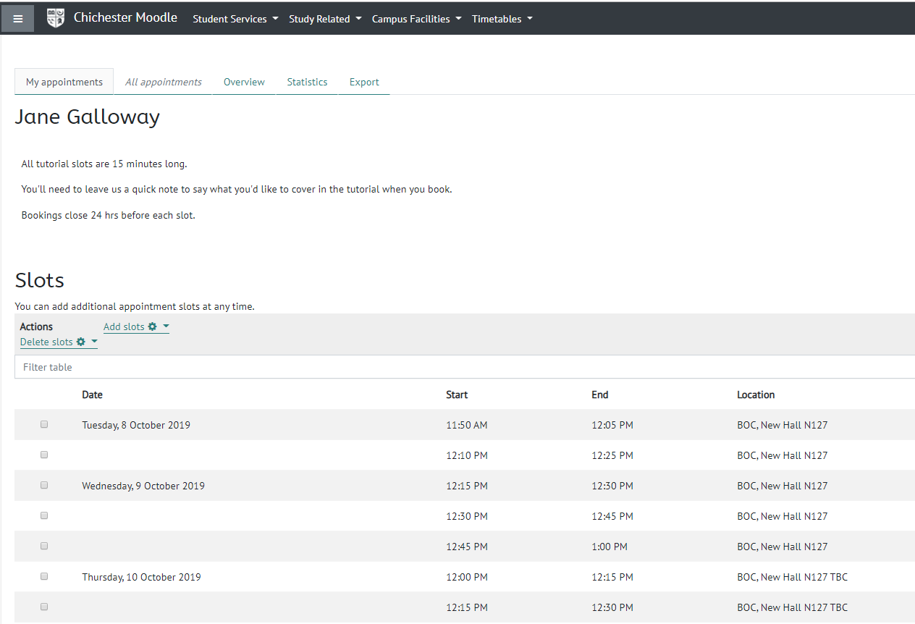
2. How to book a tutorial
Click on Tutorial slots.
Click on the tutor you'd like to see.
Choose a time.
Notes:
All students of the University of Chichester are entitled: a) To take part in an induction process which prepares them for their programme of study and gives information concerning both their programme and the support systems that are available.
As a minimum this should include the following information:
• A statement that each new student is assigned an Academic Adviser on arrival, and where information about who this is can be found; for example programme notice boards or Moodle.
• A description of how students meet their Academic Adviser for the first time, and the nature of arrangements for subsequent meetings; the description might include reference to a booking system for meetings, regular tutorial hours, or the use of email for setting up meetings or resolving issues online.
• A description about how Academic Adviser arrangements differ as students progress from year one of the programme; for example, while arrangements might be formally timetabled for first year students, second or third year students may be encouraged to

Slide 5
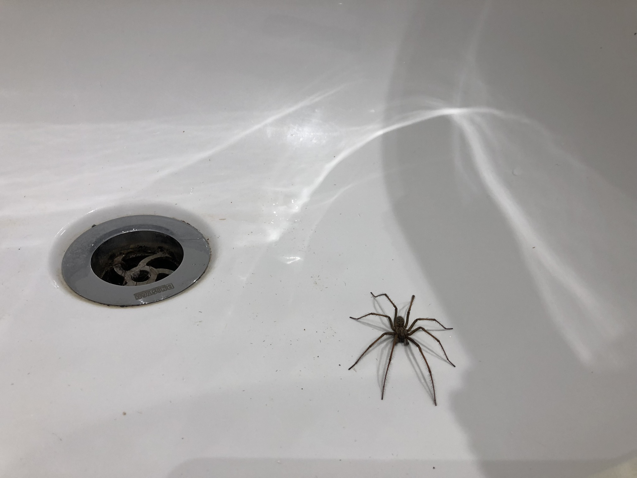
3. Your role in the process
Photo credit: Jane Galloway Sept 2019
Attendance.
If you need help, please book a tutorial.
Don’t suffer in silence.
Take ownership of any decisions and act on them, make notes, plan and engage - to get the most out of Uni life.
You can change your academic adviser – all reasonable request will be considered.
Notes:
Monitoring of Attendance (SAM)
To have in place procedures which will be followed if they fail to attend scheduled programme sessions (eg lectures, seminars, workshops) as identified by the SAM system or other established attendance monitoring processes. These procedures are documented in the ‘Student Attendance and Absence Policy’.
In some Departments the Academic Adviser will be responsible for following up students so identified.
In other Departments this will be the responsibility of the Programme Leader or Year Tutor.
Encourage students to keep their own written notes of the summary and agreed action points. This helps them to take ownership of any decisions and to act on them, rather than perpetuating a more passive ‘parent/child’ relationship in which you are expected to sort out any problems for them. Your Department may already have a formal system for recording tutorials, with a copy for the student and another for the student file in the Department office. If not, sample pro-formas can be found in ‘Tutorial Support’ on Moodle.
To have any reasonable request for a change of allocated Academic Adviser considered seriously, and an alternative proposed where possible.
Programme or Year Leaders should give consideration to how this may be facilitated within their Academic Department.
Note: we will help you as much as possible with life at university and if we cant help we will point you in the right direction. We are not here to get the spiders out the bath or help with house mate disputes of conflicts etc.

Slide 6
4. What to expect – at the first meeting
Initial aims are to:
Get to know each other a little better.
Establish a comfortable working relationship.
Photo credit: Jane Galloway Sept 2019
Notes:
The first tutorial meeting is important to help establish a comfortable working relationship.
Sue Wheeler & Jan Birtle (Wheeler & Birtle, 1993) suggest some open-ended questions as basic starting points for a first tutorial:
• Tell me something about yourself
• How do you feel about being here?
• How does the University differ from your school or college?
• What do you expect from your experience here? 11
• What kind of extra-curricular activities do you hope to become involved with?
• Is there anything that you are anxious about with respect to being a student?
• What personal resources do you have that might help you to settle in here and enjoy yourself?
• Have you thought about what kind of career you would like to follow? (Wheeler & Birtle, 1993) It is useful for you and the stud

Slide 7
4. What to expect:
Everything discussed is confidential.
Unless of course you need additional help and we may with your agreement discuss with others who can help.
Undertake personal development planning (PDP) and the Higher Education Achievement Report (HEAR*) incorporated into the personal, academic tutoring session.
Encourage you to self refer to any of the other support functions available at the university.
*The HEAR (Higher Education Achievement Report) is a University verified, electronic document which records broader achievements in addition to programme and module details and results.
Notes:
A statement of reassurance about the confidentiality of meetings with Academic Advisers, with the proviso that matters that have to be dealt with more formally may need to have confidentiality extended.
Tutorial meetings are normally managed by Academic Advisers and do not form part of the timetable.
They are therefore not usually monitored via the SAM (Student Attendance Monitoring) system and so are not subject to the same follow up procedures.
Where necessary, to be encouraged to self-refer by their Academic Adviser to one or more of the specialist Student Support and Wellbeing services or other appropriate professional department such as Finance, Student Records or Academic Quality and Standards Service (AQSS).

Slide 8
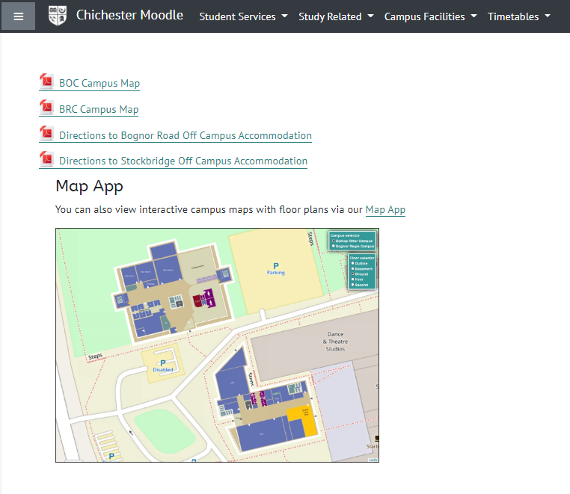
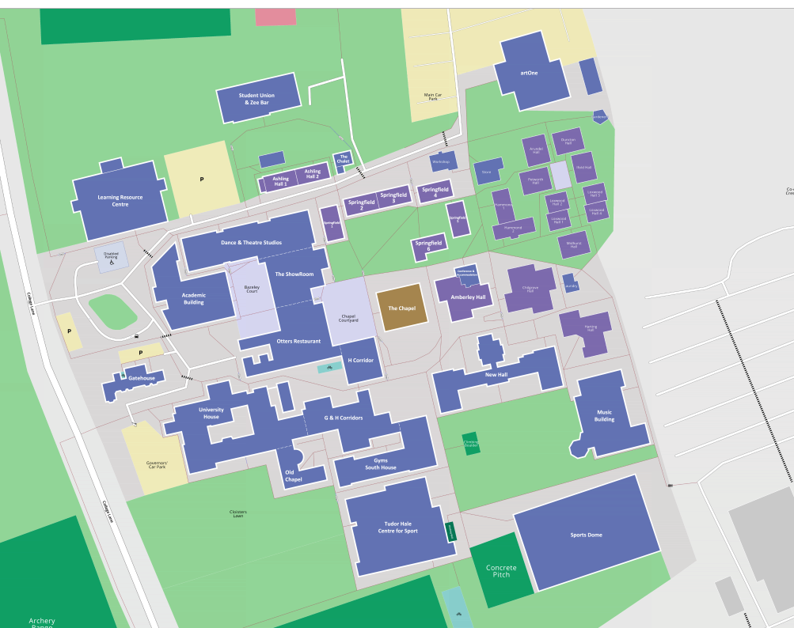
Bishop Otter Campus, New Hall, Room N131 https://maps.chi.ac.uk/#room=C18-0-28
4. How to find us

Slide 9
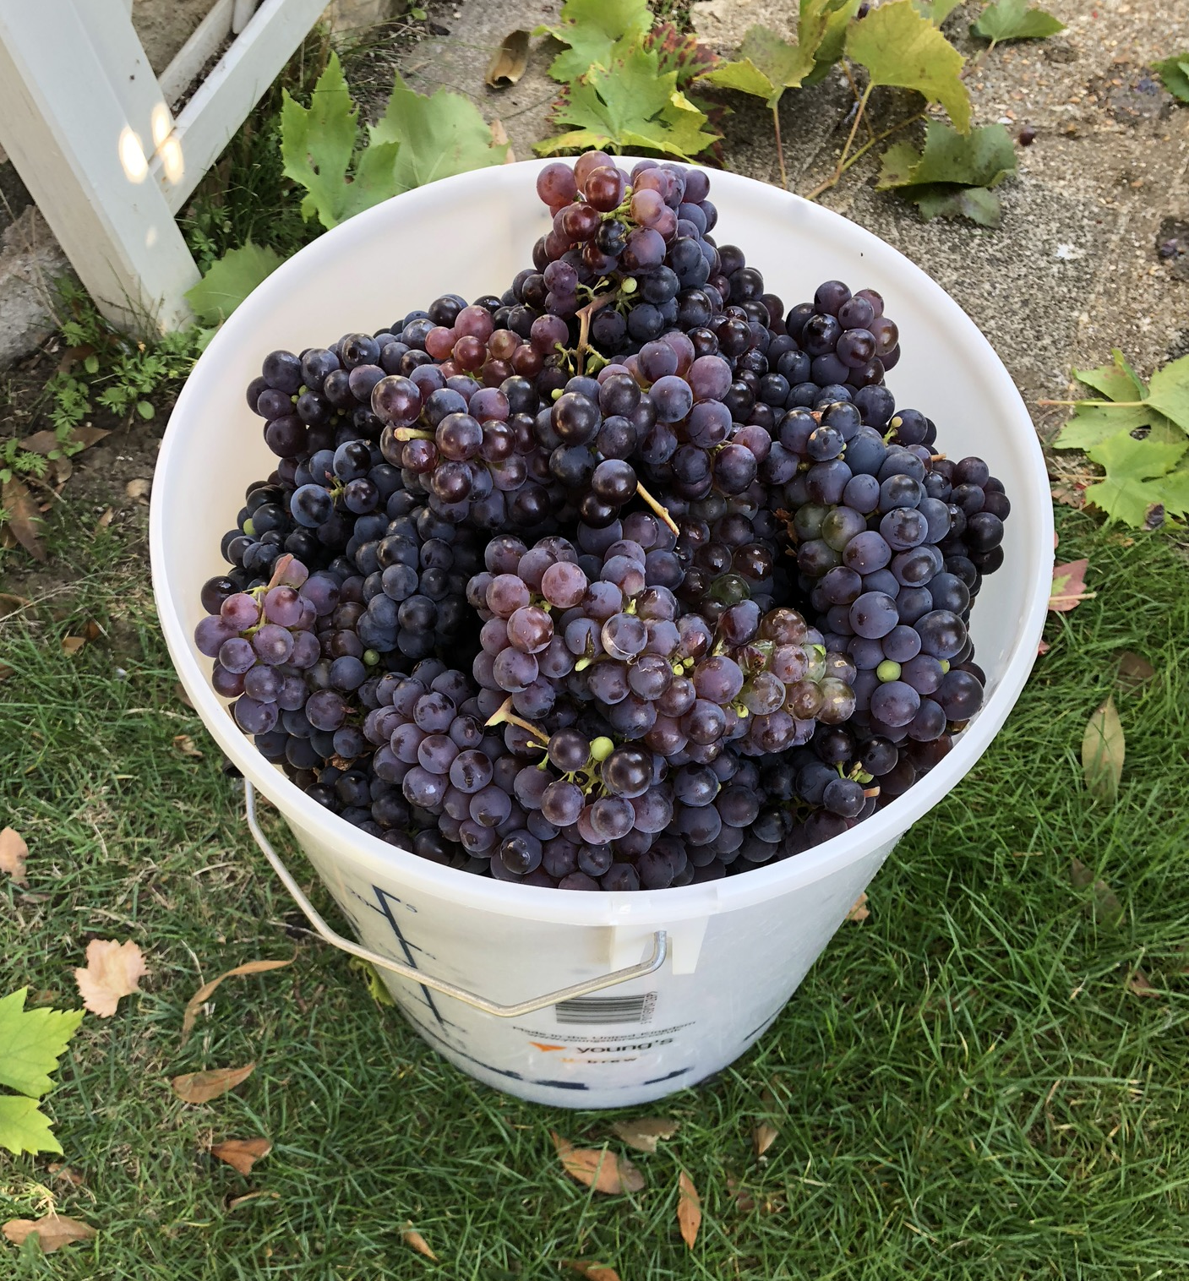
5. How often do we meet
At least once every semester
At Level 4 ideally within 3 weeks
At Level 5 within 5 weeks
At level 6 – as required
Ideally with at least 1 weeks notice
Plus ad-hoc meetings as required
Photo credit: Jane Galloway Sept 2019
Notes:
A description about how Academic Adviser arrangements differ as students progress from year one of the programme; for example, while arrangements might be formally timetabled for first year students, second or third year students may be encouraged to
This should be scheduled in a way appropriate to the specific mode of learning and may include comparable arrangements for those programmes associated with professional standards/requirements.
For first year (L4) students the first meeting should be scheduled to take place within 3 weeks of arrival with another meeting scheduled to take place to discuss progress based on marks from the first semester
Meetings with second years (L5) should be scheduled within 5 weeks of their returning
Arrangements for students in their third or subsequent year may be more flexible, reflecting other sources of academic support available e.g. for final year dissertation.
To be given reasonable (at least a week) notice of their scheduled academic advisory sessions, with reasonable efforts being made to ensure students attend the meetings to which they have been invited.
Lets not make it just an annual event like grape harvesting

Slide 10
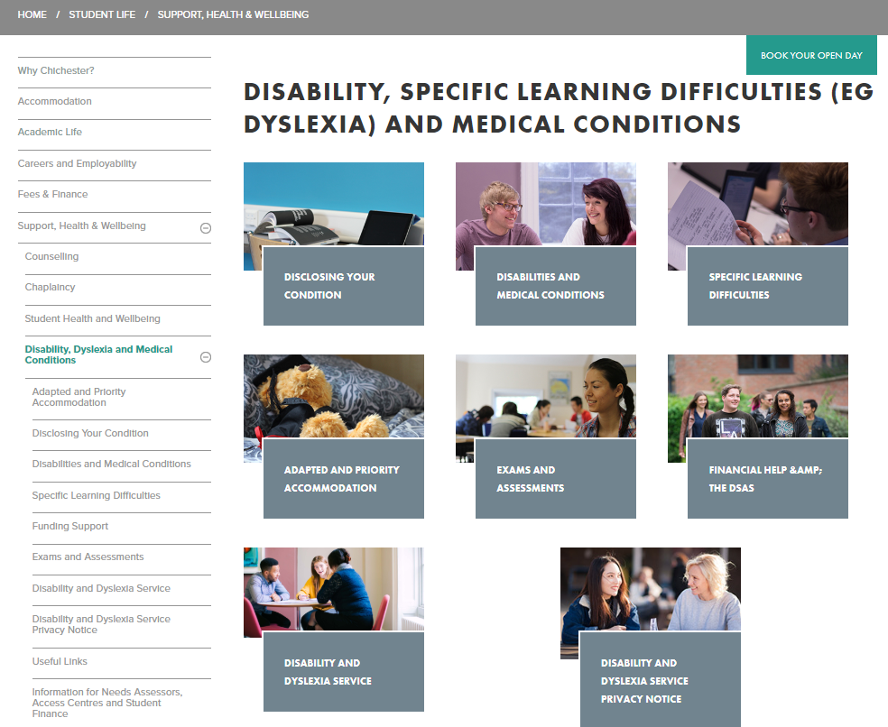
6. Additional support functions:
Student Support and Wellbeing services
Careers and Employability
Academic Skills Advice
Accommodation Service
Students Union
Notes:
Students should also be made aware of the Students’ Union and other professional services support..

Slide 11
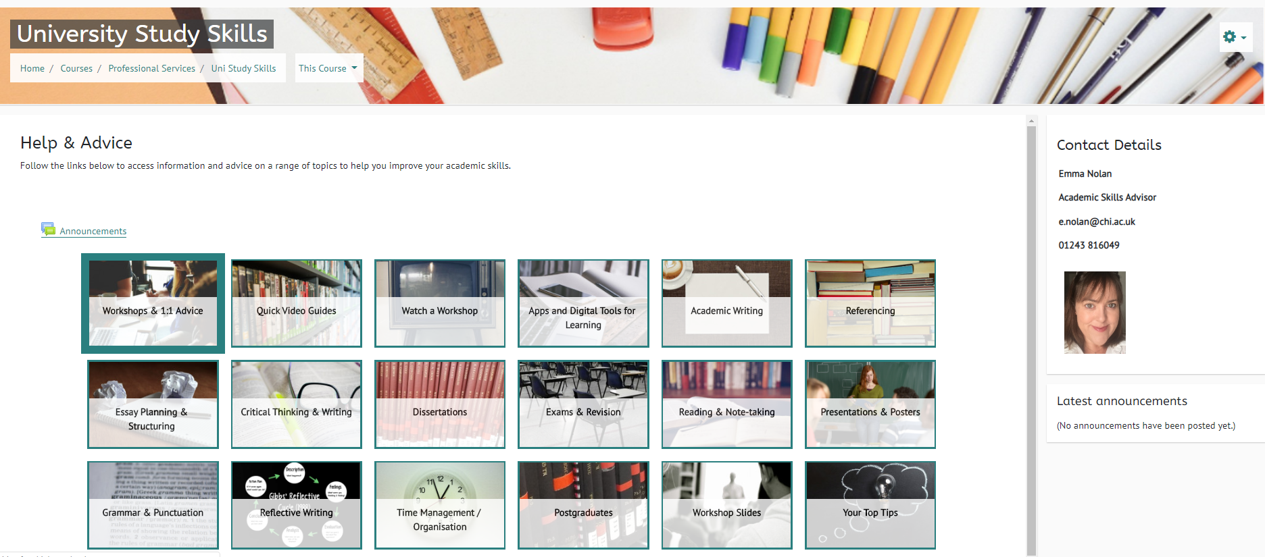
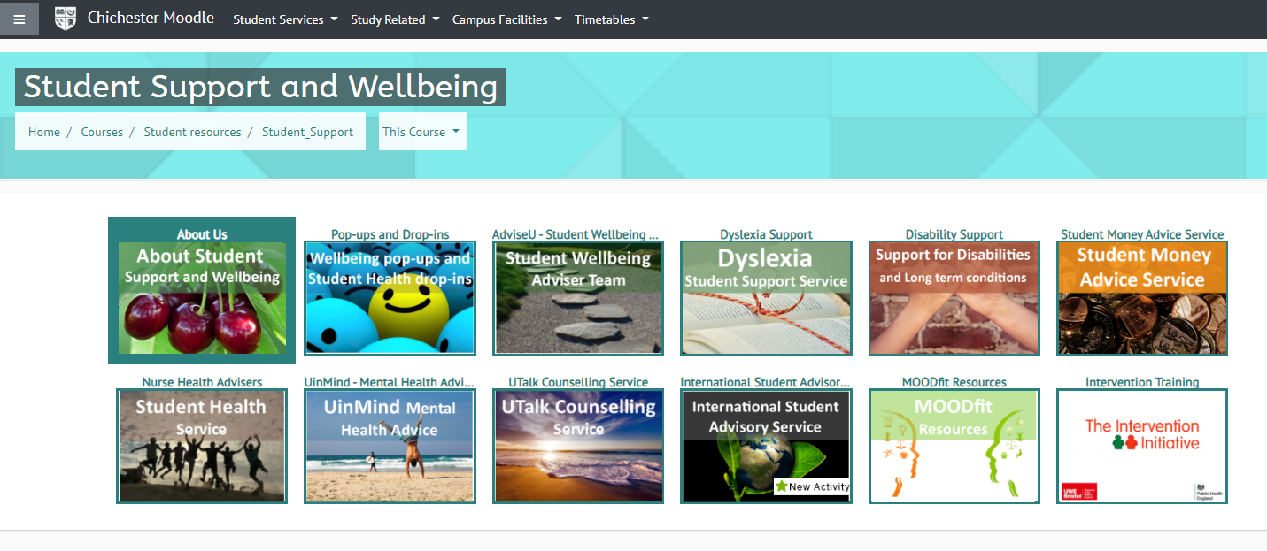
6. Additional support functions:

