Slide 1



HR / Finance / Payroll
Pre-Engagement
Suppliers Open Event
11/02/26 15:00-16:15
Teaching
Excellence
Framework
Dr Rod Matthews
February 2026
Notes:
Welcomes
Informal
Ask questions

Slide 2
Our plan for Today
Welcome
  A little About Us
Pre-Engagement
  We have undertaken widespread research
  Our Procurement Consultant has also guided us on the new processes (in new procurement act)
  Our aim is to ensure that this is a well informed process, that makes sense to most people
  Approximate Timeline
  Risks and Issues
Some opening thoughts re the requirement
  Frameworks
  Integrated or separates
  Our Tender (under construction)
  How we evaluate tenders
We welcome questions verbally and through the Chat
  We will try capture any questions and add to the website
  Names and company names are not important today
  Don't feel compelled to ask anything
  Equally, please don't stand on ceremony
  The more tricky the questions you give us, the more constructive it is for us all

Slide 3
About Us
UoC: Founded in 1839, now with over 100 building on two campuses – some heritage, some modern & 1350 student residences
Around 6374 Students in total, and around 750 FTE staff & around 1000 A/Ls and examiners etc – full on and off-site working
TEF Gold, Outstanding REF – high ranking – outstanding Student Satisfaction and retention
c£65m turn-over, and returning a surplus – despite a challenging economy
2026-7 applicants are up - fast becoming a leader in TNE
Extensive and growing conferencing, B&B, Research Partnerships, and industry partnerships work / income
We have connectivity and capacity - we are the only HE institution to have full institution wide ISO27001
Our IT Ecosystem is based on the 6Ss : Standardised, Simplified, Secure, Shareability, Supportability and Sustainable
Predominantly Microsoft, with a tight, high performing local team
HR/Payroll is Midlands, ePay WPM, Finance Unit 4 – but also, Kinetics, Tribal SITS, Power Apps, Co-Pilot
FastPath (Delinea) Ideiio – Identity Governance Administration (IGA). Creates network account in Active Directory, Entra ID for authentication (SSO using OIDC/SAML) and MFA
Whilst there are other challenges, term contracts and plans suggest no another ‘core’ system change for next 2-3 years
People: Our key experts are here from our HR, Finance and Payroll Services
We have a formally constituted project, chaired by the CHRO and Dir Finance overseen by the University’s Procurement Working Group, Capital Projects Monitoring Group and the Senior Leadership Team.

Slide 4
Pre engagement
Time (us) UK2 - Pre Engagement Notice ü
UK3 - Planned Engagement Notice Imminent
UK4 - Competitive Flexible Tender Notice On or around 2/3/26
Tender Submission Expected to be around 10 April
Potential for 1:1 Around W/C 23/4/26
Aim to finalise assessments By end April
Aim to establish preferred supplier By end of May
Aim to finalise the implementation plan By end of June
Implementation From Aug 2026 to December 2027
You: Please keep checking the website, https://help.chi.ac.uk/tenders and of course Contractsfinder
We’ve trailered the likely process, but nothing else is required ahead of submissions (c10/4/26)
Even when we publish the UK4, no expression of interest is required, however some justification is needed for a 1:1
You can submit questions at any time through tenders@chi.ac.uk - questions can be suggestions
Please read and reflect on the assessment criteria
Please don’t try to speak to our staff outside of the procurement process!

Slide 5
Why? – to Framework or not
Standard Answer: Frameworks may not have the range or new, or specialist suppliers. For us, its more or less the same amount of work to do desktop reviews and mini tenders. Frameworks are valuable and valid, and offer ‘safety in numbers’ etc. But we wish to work closely with a partner, to deliver agility and on our innovative plans.
Deeper Answer: It’s a volatile time in HEI sector – new shapes of relationship may be needed
As set out in the document, and in published response to a related question – We acknowledge the work of Sir Nigel Carrington (UUK). But, this there is work and risk involved in progressing the various perspectives and issues with shared services into actionable opportunities that address the pace and risks for us
It is possible that contracting through a Framework, as compared to directly procured and contracted may limit other aspects of consortium arrangements.
We expect of course that Frameworks will develop and reshape over time, But, for us, this is also about timing – we have no choice RE the end of term contracts and we have a change plan that we wish to progress ASARP.

Slide 6
Why? – to Integrate or not (Lotting Options)
Options
Separates ‘best of breed’ is certainly a valid strategy
An integrated ERP platform that covers it all is equally a strategy, but perhaps with less (established) suppliers
A Managed Service Provider that with an agile capability, and an outputs-based offer, is also equally a valid strategy
Sub Options
Ambivalent as to whether the solution(s) is/are cloud, or locally hosted – although locally hosted opens a further subset of questions
Each option has pros and cons;
For example: Integrations between these, and with other systems – is a hard to explain cost to a VC,
What are we open to?
Well, this is the point of pre-engagement – to ask the various experts, and make sure we don’t inadvertently exclude any candidate
How will be conclude?
We will incorporate that thinking into the tender document – so far as it doesn't structurally exclude others
We will evaluate what we think is the Total Cost and Net Risk

Slide 7
What? – Our tender may well include
A | SUPPLIER & SOLUTION PROFILE
A1 | Supplier Overview
A2 | Solution Description
A3 | Product Roadmap
B | SECTION B — FUNCTIONAL CAPABILITY (HIGHLEVEL)
B1 | HR Capability & Outcomes
B2 | Payroll Capability & Compliance
B3 | Finance Capability
B4 | Reporting & Analytics
B5 | Accessibility Compliance
B6 | Security & Privacy
C | SECTION C — INTEGRATION & DATA
C1 | APIs & Integration Capability
C2 | Data Migration Approach
C3 | Identity & Access Management
D | SECTION D — IMPLEMENTATION & CHANGE
D1 | Typical Implementation Timeline
D2 | Delivery Model & Partner Ecosystem
D3 | Payroll Assurance & Controls
D4 | Training & Adoption
E | SECTION E — SERVICE MODEL & OPERATIONS
E1 | Support & Service Levels
E2 | Configuration vs Customisation
E3 | Business Continuity & Disaster Recovery
F | SECTION F — COMMERCIALS
F1 | Pricing Model
F2 | Cost Drivers & Levers
F3 | Contract Length & Indexation
F4 | Optional Services
G | SECTION G — RISKS & INNOVATION
G1 | Key Delivery Risks
G2 | Innovation & Roadmap Highlights
G3 | Environmental Social and Governance (ESG) & Social Value
H | SECTION H — PROCUREMENT APPROACH FEEDBACK
H1 | Feedback on Procedure
H2 | Timeframes
H3 | Lotting Options
H4 | Evaluation Model Feedback

Slide 8
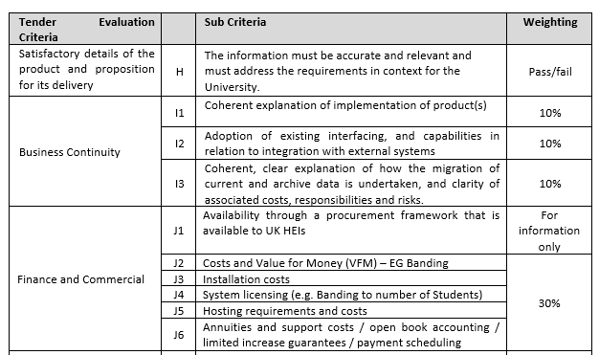
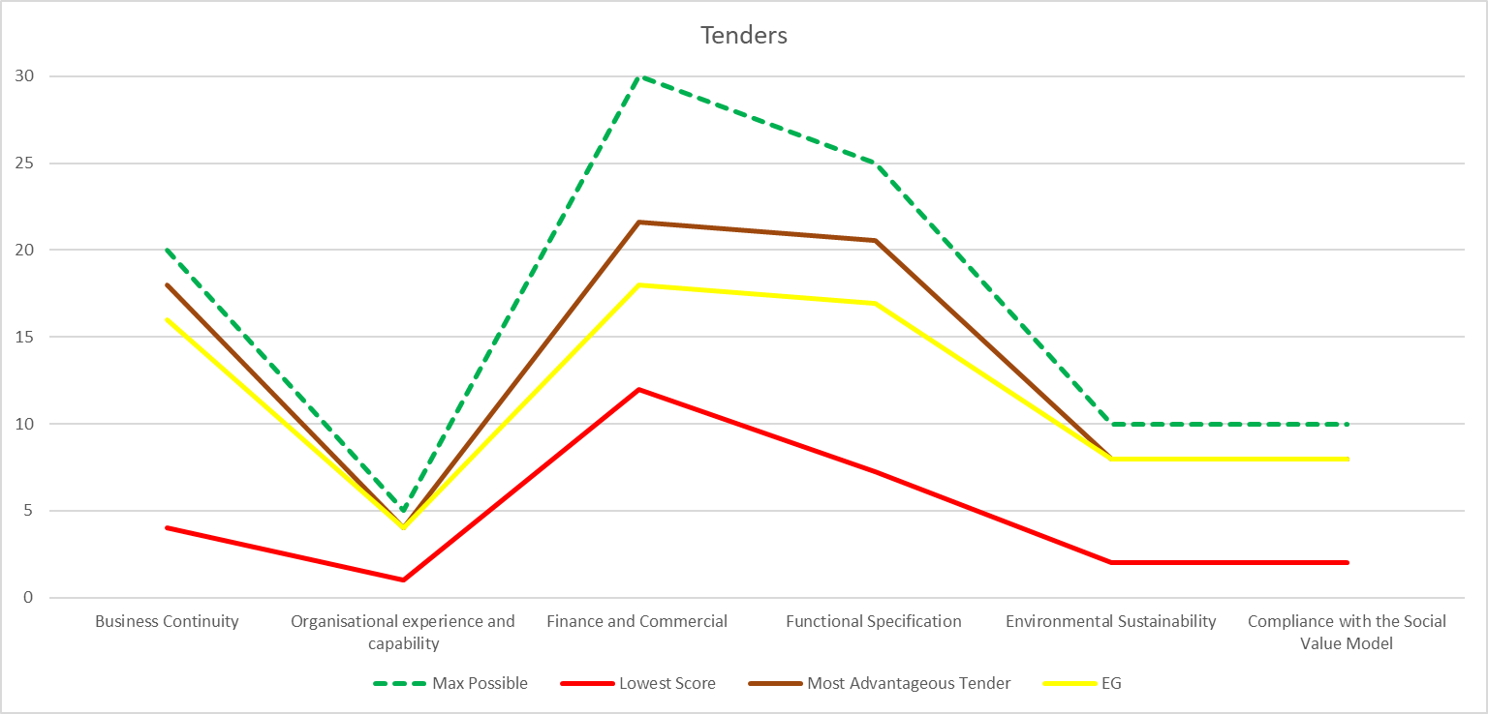
How? – Our Approach to Evaluating Tenders
Clear Relevant – Adds Vale | 5
Clear Relevant | 4
Acceptable | 3
Limited | 2
Not Clearly Identified | 1
Doesn’t mention / meet | 0
Multiple assessors – averaged, but if SD > 1 then we mediate

Slide 9
What – Risks and Issues
We don’t have enough time
Local staff are too busy working, to support change
Costs of change - timing / forecasts
We make this over complicated
We make this too flexible
Our existing environment is too bespoke
We over / under spec
Suppliers are not interested
We have dual running costs
Volatility in HEIs, become reflected in HEI supplier costs
Another ‘Broadcom’
OfS becomes directive on sourcing and contracting
We want to be your special customer

Slide 10
What – What have we missed?
Any remaining Questions, Statements – recommendations ?
UK3 will likely be next week (doesn’t say much)
UK4 is the main event – we anticipate W/C 2 March

Slide 11
HR / Finance / Payroll
Pre-Engagement
Suppliers Open Event
11/02/26 15:00-16:15
Teaching
Excellence
Framework
Dr Rod Matthews
February 2026

