Slide 1



HR / Finance / Payroll
Suppliers Open Event
26/03/26 09:00-09:45
Teaching
Excellence
Framework
Dr Rod Matthews
March 2026
Notes:
Welcomes
Informal
Ask questions

Slide 2
Our plan for Today
Welcome
Questions and Answers retrospective
Timetable
Tender Evaluation
Questionnaire
Open for further Q&A
Final Timetable // Next Steps

Slide 3
Q&As Retrospective
Why tender and not just go to frameworks
What is our vision for HR/Finance/Payroll for the longer term
Lots Consortiums, Separates, integrated ERPs etc
Shared Services
Size of our budget
There was a change in the tables between UK3 and UK4 assessment criteria
There was a change in the apportionment of weighting
Do we have an implementation team
When can we meet on a 1:1 basis
Are there opportunities to phase in the implementation
If so, how do we show like for like costs
Whose Ts and Cs will apply

Slide 4
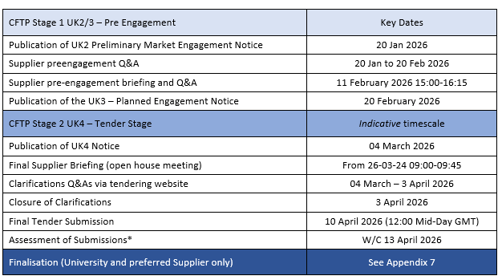
Timetable
I was 2 days late as there was a glitch with F-A-T
You: Please keep checking the website, https://help.chi.ac.uk/tenders and of course Contractsfinder
You can submit questions at any time through tenders@chi.ac.uk - questions can be suggestions

Slide 5
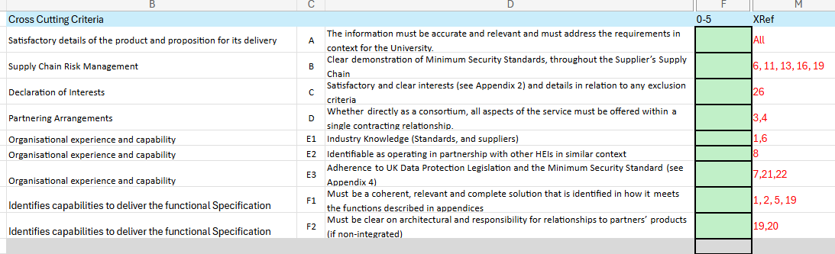
The contextual criteria (as in tender Document)
Clear Relevant – Adds Vale | 5
Clear Relevant | 4
Acceptable | 3
Limited | 2
Not Clearly Identified | 1
Doesn’t mention / meet | 0

Slide 6
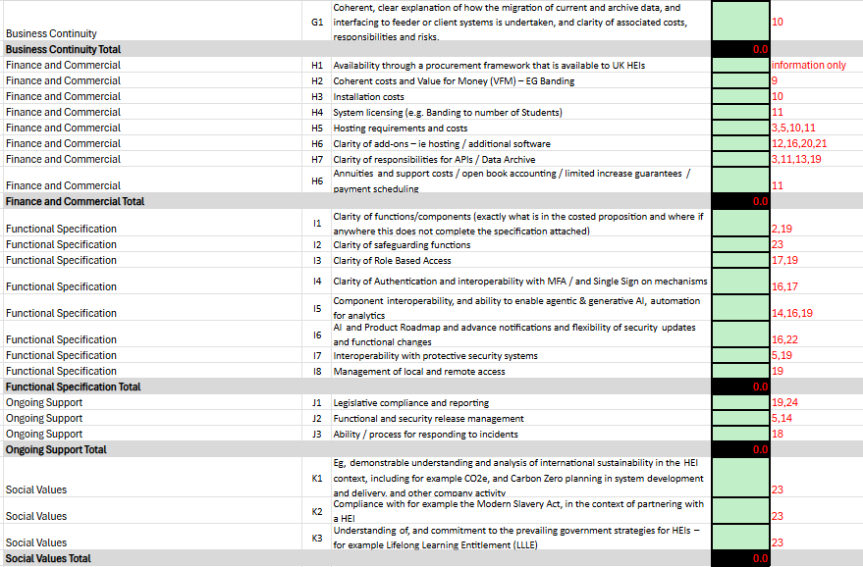
The Core Assessments (as in tender document)

Slide 7
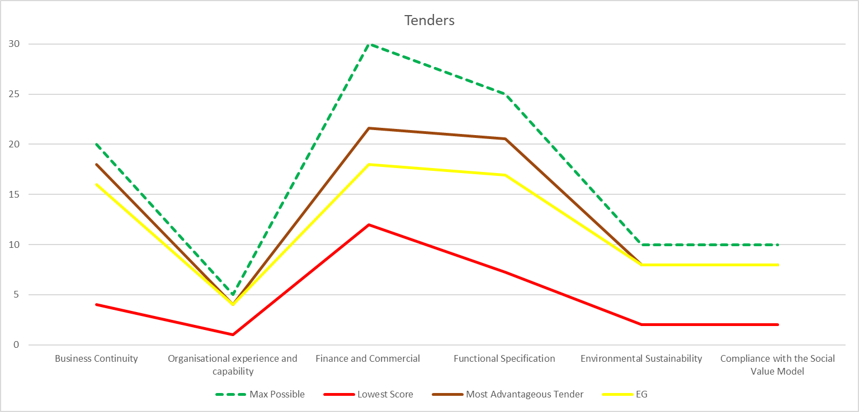
How? – Our Approach to Evaluating Tenders – including a summarisation chart
100

Slide 8
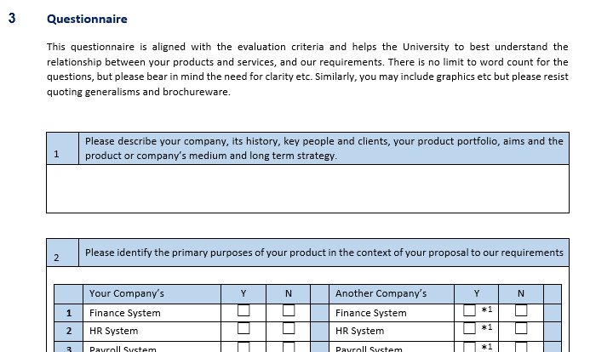
Please help us -
Ok, so there is no limitation / word count – but...
Notes:
If you paint too far outside the lines, we may not understand the picture

Slide 9
Further Q&A –
You: Please keep checking the website, https://help.chi.ac.uk/tenders and of course Contractsfinder
You can submit questions at any time through tenders@chi.ac.uk - questions can be suggestions

Slide 10
Final slide –
We want to be your special customer – I can safely say that after nearly 12 years here, there is something special about UoC
We have tried to walk a line between flexible, and open – this is not easy
We have tried to get answers promptly, and our process has made that data available to all
We are conscious that most people are experiencing the PPA 2023 for the first time
We feel like we’re under a lot of scrutiny to be open, and nonprescriptive
Assessment will also be open and transparent – no one person’s view can skew results, but equally, I’m aware that averages tend to favour mundane outcomes
I do hope you will wish to submit a proposal, and remind you that close of submissions is 10/4 at 12:00 – by email to tenders@chi.ac.uk

Slide 11
HR / Finance / Payroll
Suppliers Open Event
26/03/26 09:00-09:45
Teaching
Excellence
Framework
Dr Rod Matthews
March 2026
Notes:
Welcomes
Informal
Ask questions

